Slide 1
ATTRITION ANALYSIS

Slide 2
INTRODUCTION
RETENSION is a cornerstone of any successful organization .
But a XYZ COMPANY which thrives on values like innovation and collaboration
has faced a persistent challenge of high ATTRITION RATE in couple of years.
This report utilizes HR analytics to explore the data behind this unexpected trend and aim to develop targeted strategies that not only retain talent but also empowers them to excel.

Slide 3



DETAILS OF DATA
TOTAL EMPLOYESS 4410
ACTIVE EMPLOYESS 3699
TOTAL ATTRITION 711

Slide 4

MAIN KPI ‘s
ATTRITION - GRADUAL LOSS OF EMPLOYESS
ACTIVE EMPLOYEES – EMPLOYEES WHO ARE STILL WORKING IN THE COMPANY
TOTAL ATTRITION – EMPLOYEES WHO HAVE LEFT THE COMPANY
WORK LIFE BALANCE SCORE – AVERAGE SCORE BASED ON Work LifeBalance column
GENDER DISTRIBUTION – TO UNDERSTAND THE GENDER DISTRIBUTION

Slide 5
MOCK – UP DASHBOARD
The main goal is to gather constructive feedback to improve the final product
TOTAL EMPLOYEES
4410
TOTAL ATTRITION
711
ACTIVE EMPLOYEES
3699
AVERAGE AGE
33
MONTHLY RANGE
COUNT OF ATTRITION
AGE RANGE
ATTRIBUTION BY
AGE
ATTRITION By Martial Status

Slide 6
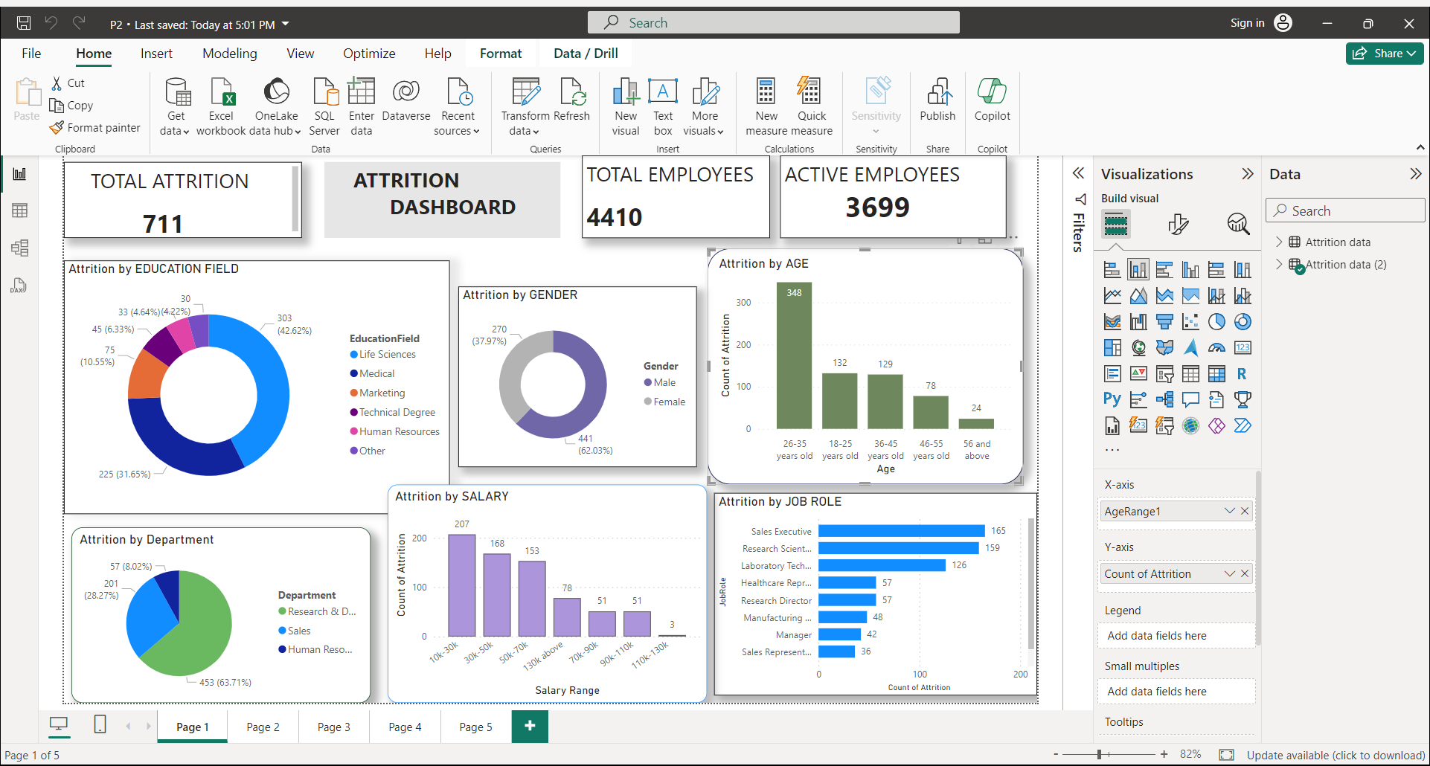
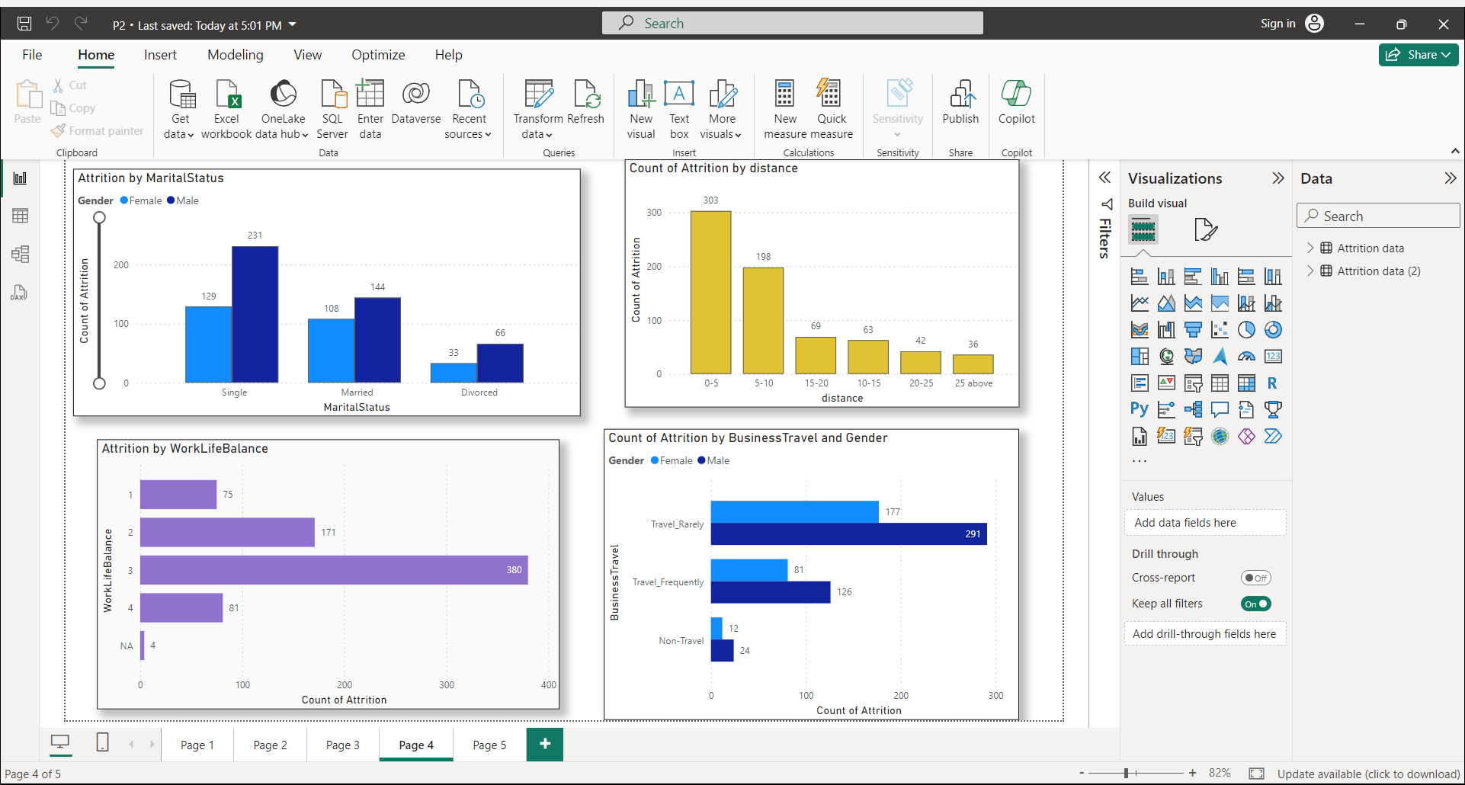
MY DESIGN

Slide 7
Thank you!

